Slide 1
A Distributed Face Recognition Application
Feature
Distributed
AI
Container Based
Verified in:
Arktos
Vanilla K8s V1.19

Slide 2






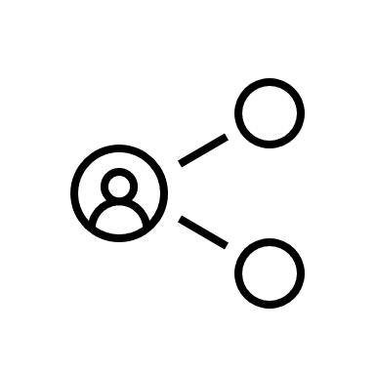
FrontEnd
1. Issue request
2. Insert DB
receiver
mysql DB
pic storage
3. produce msg
8. Update DB
6. grab data
message queue
4. consume msg
5. request face recognition
7. face recognition result
face recognizer
Image processor

